Slide 1

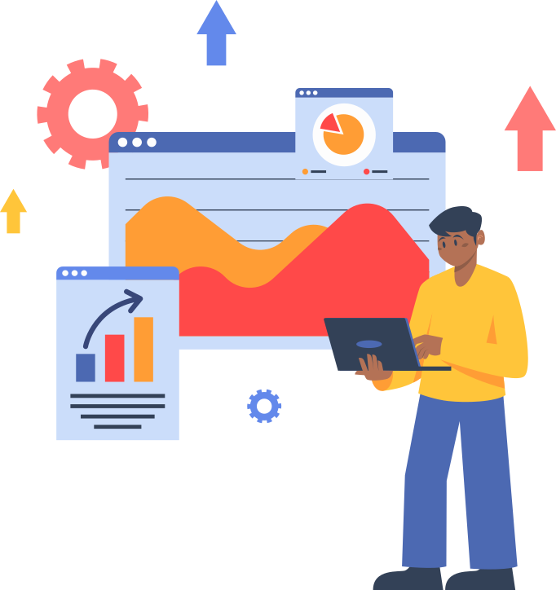
6th Grade
Information System Strategic Management
by: ola sherif

Slide 2


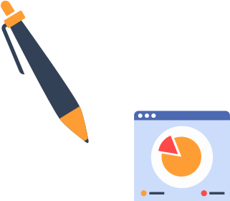
Table of contents
01
Chapter Five
STRATEGIC ALIGNMENT
02
Chapter Six
COMPETITIVE ADVANTAGE FROM INFORMATION SYSTEMS

Slide 3


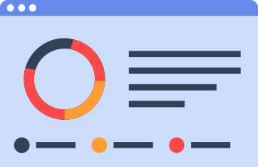








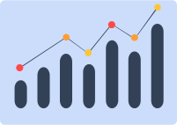
01
Chapter Five:STRATEGIC ALIGNMENT

Slide 4


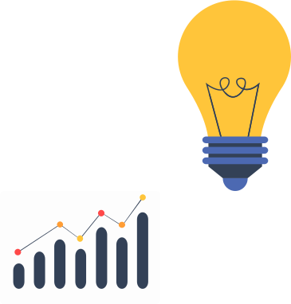
Main Idea
The chapter discusses how to align an organization’s strategy (its overall goals and managerial direction) with its Information Systems (IS) strategy and Information Technology (IT) strategy.
It’s not just about choosing technology or information systems; rather, it is about:
How information and technology can support the organization’s strategy and how the organization itself can be strengthened through effective use of information.

Slide 5
Chapter Introduction
The chapter explains that:
Companies need alignment between:
Corporate Strategy
Information Systems (IS) Strategy
Information Technology (IT) Strategy
This alignment is not just about selecting computer programs to support management.
Rather, it is an ongoing process that involves planning and a deep understanding of the company's information needs.

Slide 6
Main points
The Alignment Problem
The main issue is:
Some companies do not even have a clear strategy in the first place — so how can IT be aligned with it?
Others treat Information Technology as something separate from the business, and this is a mistake.
An important example:
Companies that rely on technology in their products (such as electronics or automobiles)… in this case, technology itself drives the company’s strategy, not the other way around

Slide 7
Alignment Model
There are four elements that must be aligned:
Corporate Strategy
Business Strategy
IS Strategy
IT Strategy
And all of them must be consistent with:
Information Needs
This relationship is ongoing, not a one-time process
.Case Study: British Universities
The study found that:
Only a few universities have a full Information Strategy.
Most of them have only an IS Strategy or an IT Strategy, but not an overall information strategy

Slide 8
There is no strong alignment between the university’s general strategy and its IS/IT strategies.
The recommendations were:
The need to link the university’s information to its strategic goals.
Planning and controlling investments in information systems.
Identifying the resources required to develop IS and IT.
Stages of Information Systems Planning – Earl (1989)
presents five stages — called the IS Map — that help determine where the organization currently stands:
Stage Idea
1. IS/IT Mapping
Collecting information about existing systems
2. Business Direction
Linking IS with business needs
3. Detailed Planning

Slide 9
Detailed planning and linking top-down and bottom-up approaches
4. Competitive Advantage
Using IT to achieve competitive advantage
5. IT Strategy Connection
Full integration between IS, IT, and the company’s overall strategy
Important: A company may be a mixture of these levels, not just at one single stage.
Business Domain & IS Domain
The chapter divides the organization into two main domains:
Business Domain
Business Strategy
Business Organisation
IS Domain
IS Strategy
IS Infrastructure & Processes
These four areas must remain aligned with each other continuously.

Slide 10
Information Needs Analysis
Identifying information needs is done through four aspects:
External Environment: economy, politics, inflation, etc.
Company Environment: its specific market.
Marketing Environment: SWOT + PEST analysis.
Company Values and Goals: what the organization aims to achieve.
This part is very important because it forms the foundation of the entire planning process.
Business Domain Analysis
The main tool used in the chapter is:
Porter’s Value Chain
But it should be used as an integrated framework, not as separate functions.
.

Slide 11
Chapter Summary
The chapter explains that:
Information is the starting point.
All strategies (Corporate, Business, IS, IT) must be continuously aligned.
Identifying the required information is the most important step.
There are four approaches to viewing alignment, and the appropriate one should be chosen based on the nature of the organization.
Planning is a continuous process, not a one-time event.
.

Slide 12
Information Needs AnalysisAl
Identifying information needs is done through four aspects:
External Environment: economy, politics, inflation, etc.
Company Environment: its specific market.
Marketing Environment: SWOT + PEST analysis.
Company Values and Goals: what the organization aims to achieve.
This part is very important because it forms the foundation of the entire planning process.
. Technology Potential
Start from the available technology and build the strategy around it.
Suitable for technology-driven companies.
. Competitive Potential
Using IT to gain a competitive advantage.
Adjusting the business strategy to take advantage of new technologies.
.
.

Slide 13
4. Service Level
Focus on the IS Strategy and IS Infrastructure to improve internal service.
Risk: It may drift away from the business strategy

Slide 14
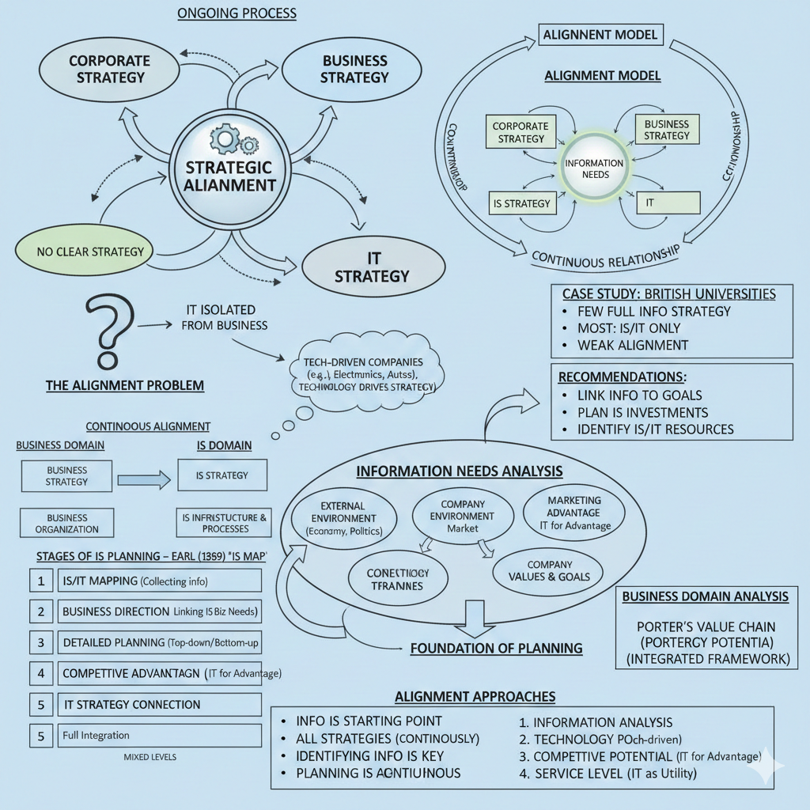
mind map

Slide 15
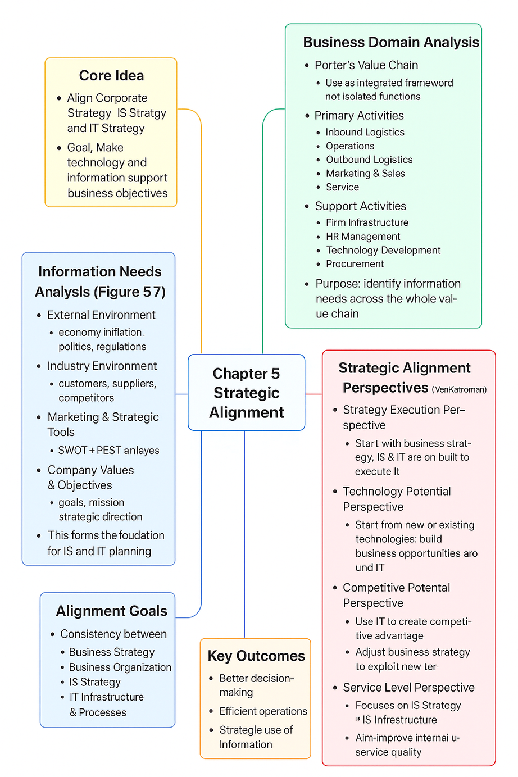
graphical summary

Slide 16
practical side
Strategic Alignment practical side
1- start by Identifying Information Needs:
Before anything else, determine what information is essential for your company or organization.
Examine the external environment (market, competitors, economy) and the internal environment (culture, structure, values).
2-Understand the Current Company Status:
Identify where you currently stand in using information systems and technology (IS map).
Are you using advanced or basic systems? Does the technology support current operations, or is it misaligned?
3-Analyze the Key Domains:
Business Domain: business strategies, organizational structure, core operations.
IS Domain: IT infrastructure, systems, procedures, and information strategy.

Slide 17
4-Choose an Alignment Perspective:
Strategy Execution: strategy is the main driver, and structure and technology adapt to it.
Technology Potential: technology leads, and the business adapts to what it provides.
Competitive Potential: use IT to gain a competitive advantage and adjust strategy according to new opportunities.
Service Level: focus on improving IS capabilities to enhance business performance.
5-Continuously Apply the Alignment Model:
Always link corporate strategy, business strategies, and information systems strategies.
Use tools such as Porter’s Value Chain, Strategic Grid, and Technology Grid to monitor current and future status.
6-Monitor New Technologies and Applications:
Some applications or technologies may have high potential but are new (High Potential).
Follow the lifecycle of technology and applications to decide when to adopt them or phase them out.

Slide 18
2
Chapter Six:COMPETITIVE ADVANTAGE FROM INFORMATION SYSTEMS

Slide 19
Chapter Introduction
he chapter discusses the idea that information, information systems (IS), and information technology (IT) can provide an organization with a competitive advantage over its competitors.
This idea gained strong attention in the 1980s and was linked to many studies showing how new technologies—such as databases and networks—could help companies achieve superiority.
However, the issue is not simple… and several important questions arise:
Does competitive advantage come from the technology itself?
Or from the way it is used within the organization?
Is the competitive advantage gained from information sustainable?
Can a company maintain it for years?
Can this advantage be planned?
Or does it happen by coincidence?

Slide 20
main points
The theoretical background of the concept of competitive advantage.
Whether the advantage comes from IT, IS, or information itself.
Why organizations should be viewed as systems.
Whether it is possible to sustain a competitive advantage gained from information.
Whether this advantage can be planned in advance.
Porter’s Three Generic Strategies
Michael Porter introduced the idea that competitive advantage comes from three basic strategies:
Cost Leadership
Producing at a lower cost than competitors.
Example: Banks that used ATMs to reduce staff and cut costs.

Slide 21
Differentiation
Making the product or service different from competitors.
Example: Insurance companies that offered services over the phone instead of traditional branches.
Focus
Targeting a specific market segment with greater expertise and understanding.
Most IS applications have focused on cost reduction and differentiation.
IT, IS, or Information?
This is a very important point in the chapter:
Information = the broadest concept; all information within the organization and among employees.
Information Systems (IS) = the systems and methods (not necessarily technological) that help manage information.

Slide 22
Information Technology (IT) = the computer hardware and software used within the system.
So:
Information is the foundation, IS manages it, and IT is just a tool within the system.
Example to illustrate the idea:
Kanban in car manufacturing (without technology!)
Vauxhall used paper cards to track production components — not computers!
Yet it was a successful information system because it supported the larger system.
Organizations as Systems
he chapter emphasizes that an organization is:
An open system that is influenced by its environment (market, politics, competitors).
A human activity system.
It has:
Boundaries

Slide 23
Interdependence
Communication and control
Hierarchy
Transformation (Inputs to Outputs)
Therefore, technology alone is not enough… what truly matters is how it is used within the human system.
Can Competitive Advantage Come from IT?
Most studies say:
The advantage does not come from the technology itself,
because competitors can buy the same technology.
The real advantage comes from:
How the technology is used

Slide 24
Internal organization
Human skills
Management processes
Examples:
American Airlines – SABRE System
The advantage came because they used the system better — not because of the system itself.
Baxter Healthcare
They sold their system to competitors and still kept their advantage because of their service and the way they used it.
Is Competitive Advantage Sustainable?
It is sustainable only in the short term.
Because:
Competitors can imitate quickly.
Technology becomes widespread.

Slide 25
Most advantages end up changing the structure of the industry rather than giving one company long-term superiority.
The only almost sustainable advantage is the human advantage:
Employee expertise
Organizational culture
Skills in using information
Innovation
Flexibility
Example: Tesco Loyalty Cards
Tesco introduced loyalty point cards and gained new customers.
Later, all competitors adopted the same idea.
Result:
The advantage disappeared and became an industry-wide feature rather than a competitive one.

Slide 26
Can Competitive Advantage Be Planned?
The chapter states:
It is not possible to guarantee a planned competitive advantage from information.
But it is possible to plan for the strategic management of information,
and this can provide a general advantage—though not a permanent one.
What matters most is:
Aligning IT and IS and the organization’s goals
(as discussed in Chapter 5).
Analysis Frameworks
1. Industry Analysis
What is the role of information in the industry as a whole?
How information-intensive is the product?
How information-intensive is the value chain?

Slide 27
Positioning the Organisation
Where does the company stand compared to competitors?
3. Internal Analysis
What are the strengths?
Employee skills?
Internal systems?
Technology in use?
How ready is the organization for change?
Chapter Summary
Competitive advantage does not come from technology
It comes from organization + people + intelligent use of information.
What is required is not “planning to gain an advantage
but managing information intelligently and continuously.

Slide 28
practical side
How to gain and manage competitive advantage from information systems (IS/IT)
Step 1: Understand your industry
Analyze your industry to see where information is most critical.
Use Porter’s Five Forces to identify threats and opportunities.
Check how competitors use information and technology.
Step 2: Position your organization
Identify your organization’s position in the market.
Decide whether to pursue cost leadership, differentiation, or focus.
Understand which strategy aligns with your organization’s goals.
Step 3: Map internal processes
Analyze all internal processes (value chain: operations, logistics, sales, HR, etc.).
Identify where information flows and where systems are used.
Look for linkages between activities that can create advantage.
Step 4: Implement or improve IS/IT

Slide 29
Choose technology that supports your information needs (databases, networks, ERP, CRM, etc.).
Remember: IT alone doesn’t give advantage; effective use does.
Train staff to use systems efficiently.
Step 5: Use information strategically
Collect and analyze relevant information to support decision-making.
Improve customer service, operational efficiency, or product/service differentiation.
Monitor how competitors use similar information systems.
Step 6: Focus on human factors
Develop staff skills, knowledge, and experience.
Encourage innovation and adaptability.
Make sure human processes integrate with information systems.
Step 7: Monitor and update
Continuously assess whether IS/IT supports competitive advantage.
Adjust systems, processes, and strategies as the market and technology evolve.
Track industry trends and competitor moves.

Slide 30
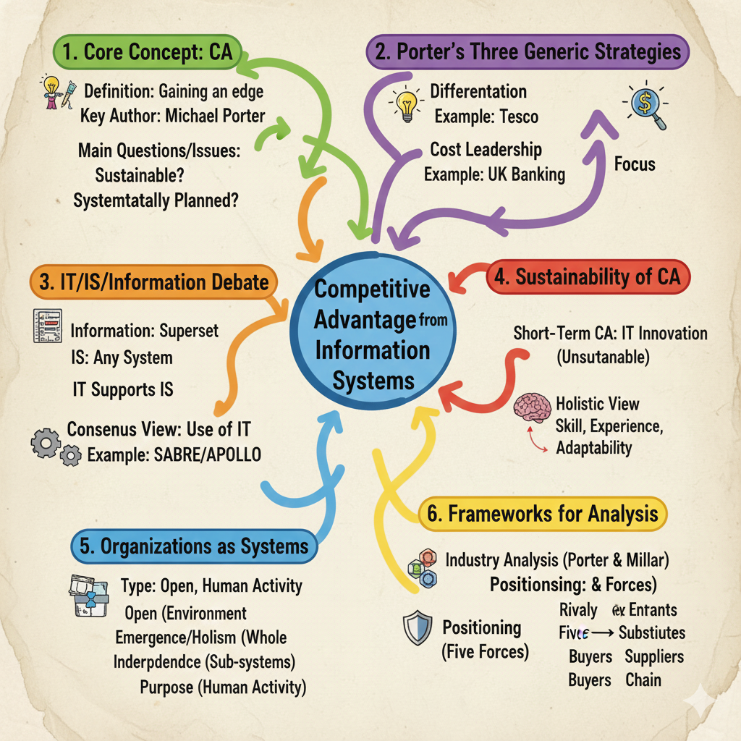
mind map

Slide 31
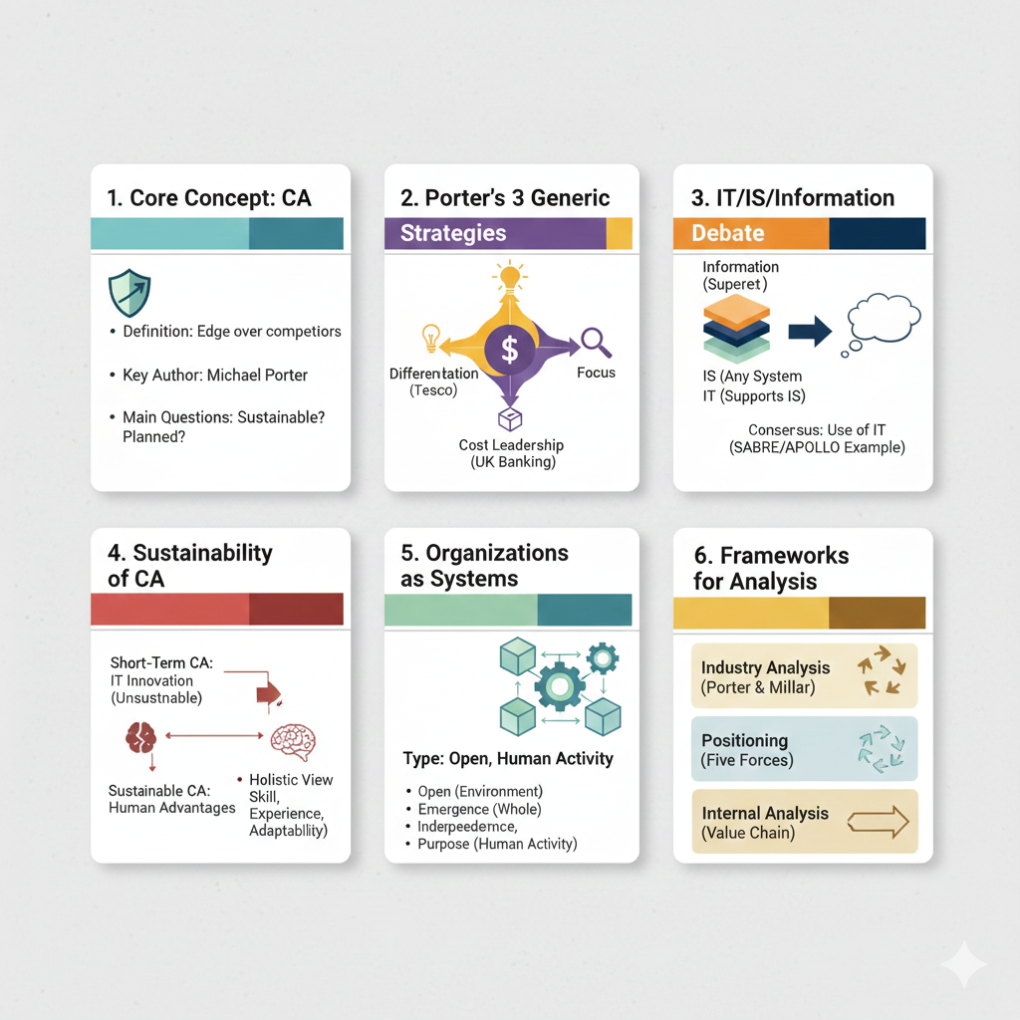
graphical summary

Slide 32


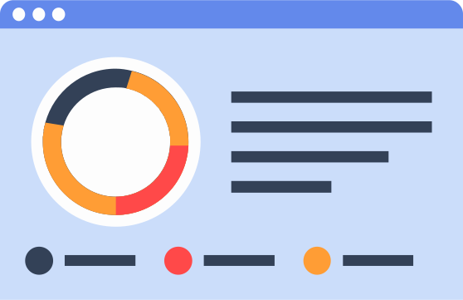






thank you
Under the supervision of Dr. Amany Ashraf

